Slide 1
RUSHHOUR project
Iris and Roman

Slide 2
Introduction
Winning the game
Setting up the board
State space
Structuring our code
Random solving
Breadth First Search
Depth First Search
Results
Conclusion

Slide 3
State space
Game 1 = 1.000.000
Game 2 = 976.562.500
Game 3 = 976.562.500
Game 4 = 1,94E19
Game 5 = 2,12E21
Game 6 = 1,04E23
Game 7 = 1,44E45

Slide 4



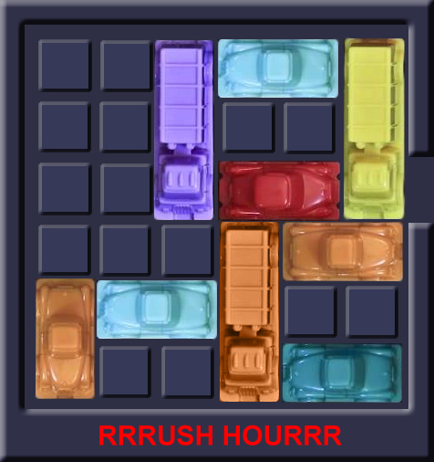
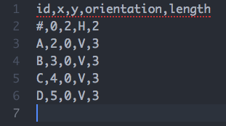
Code structure
Classes:
Vehicle
Information about vehicle
Gameboard
Takes list of vehicles
Grid
Move function
HasSolved
Dimensions
Global width x height

Slide 5
First algorithm: Solve randomly
Pseudocode
Make copy of gameboard
While True:
Select random vehicle list from move function
Create new gameboard with vehicle list
Break if gameboard is solved

Slide 6
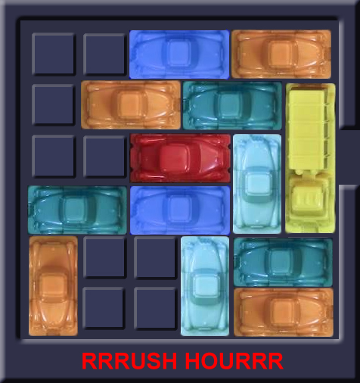
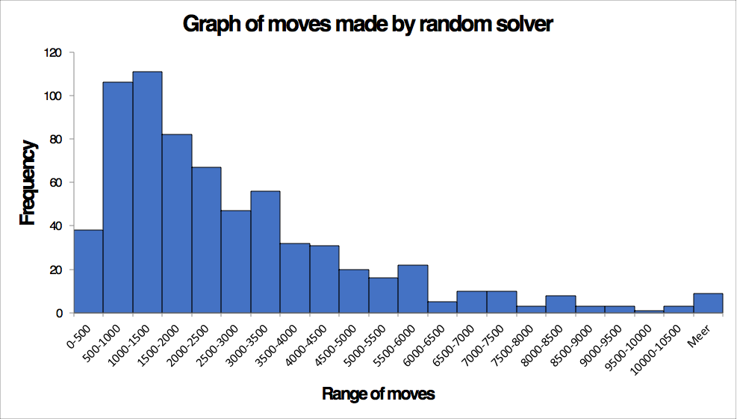
Random solving of board 2 Most steps: 14926 N = 683 Least steps: 209

Slide 7
Second algorithm: Breadth First Search
Pseudocode:
Initialize queue
Initialize dictionary -> archive
add initial gameboard to queue
add initial gameboard to archive
While queue is not empty:
Remove gameboard from queue
check if gameboard is solved
else:
for each child in possible move:
create gameboard
check if gameboard is in archive
else:
append child to queue
append child to archive

Slide 8
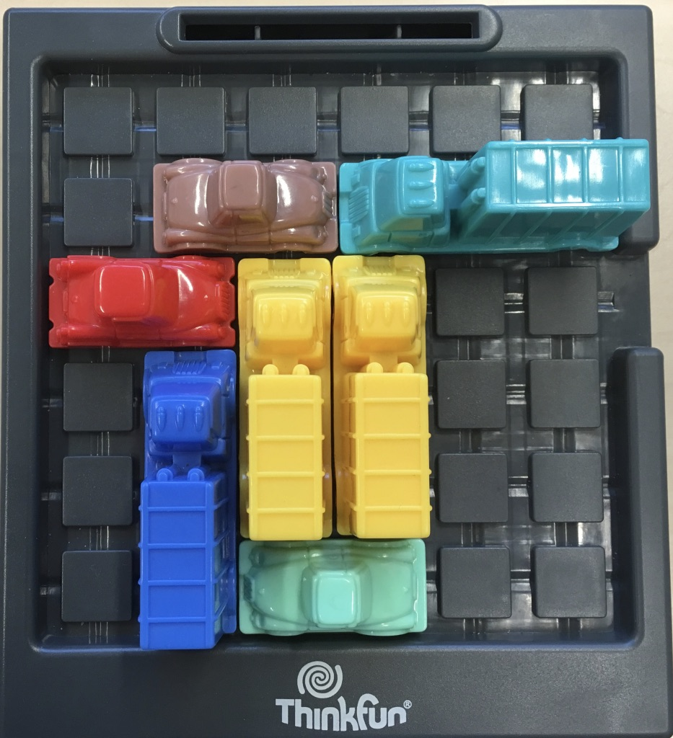
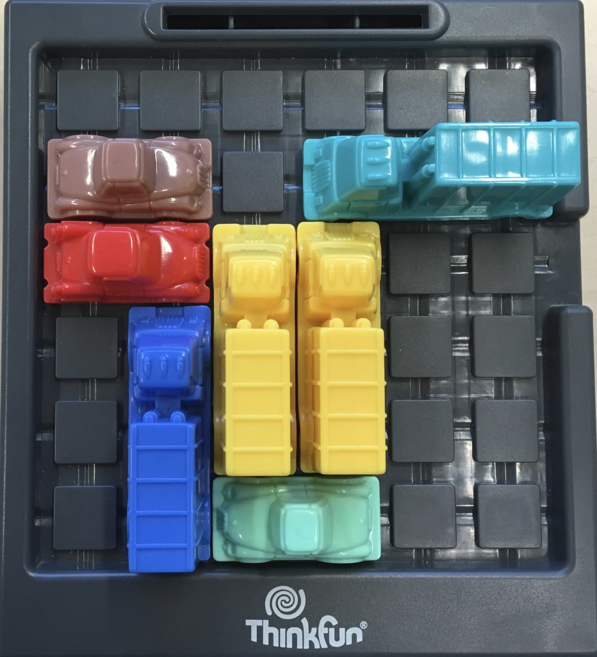
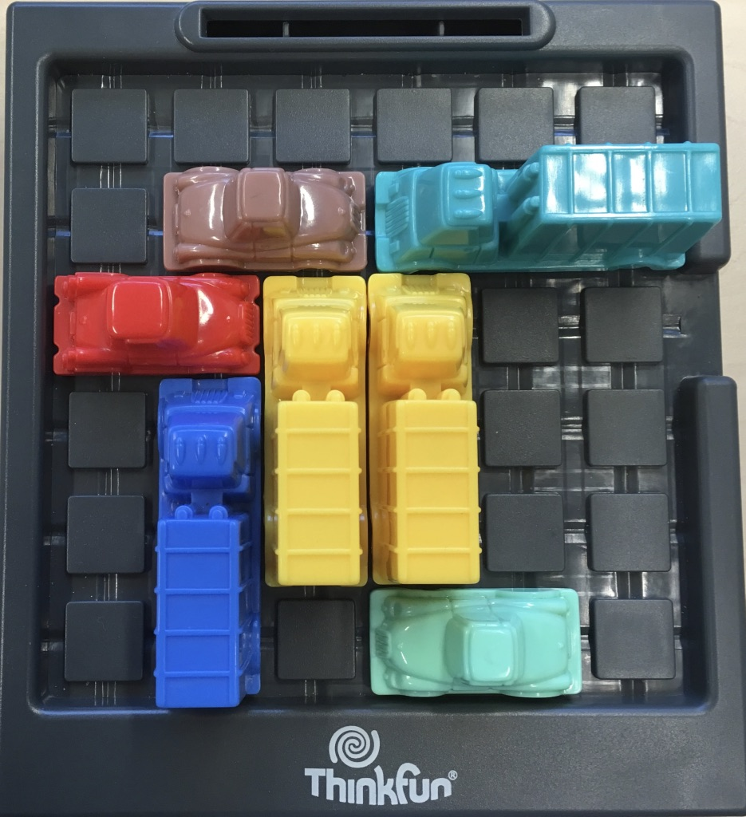
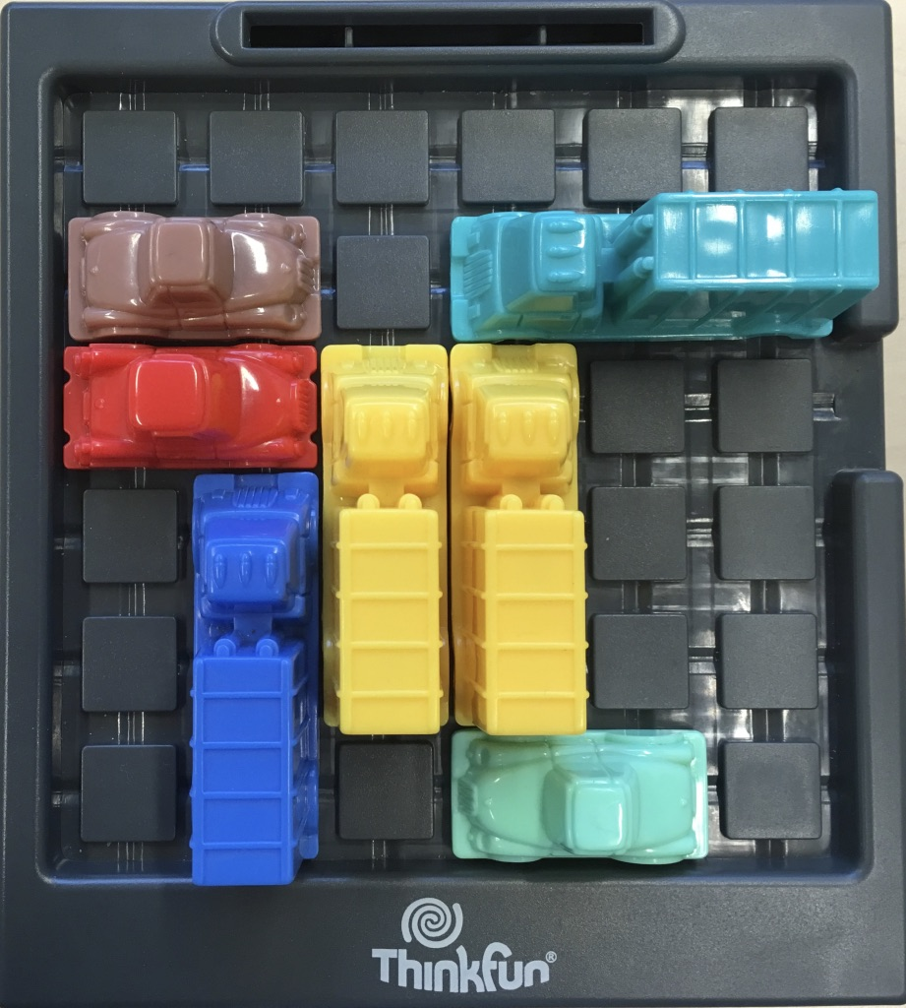
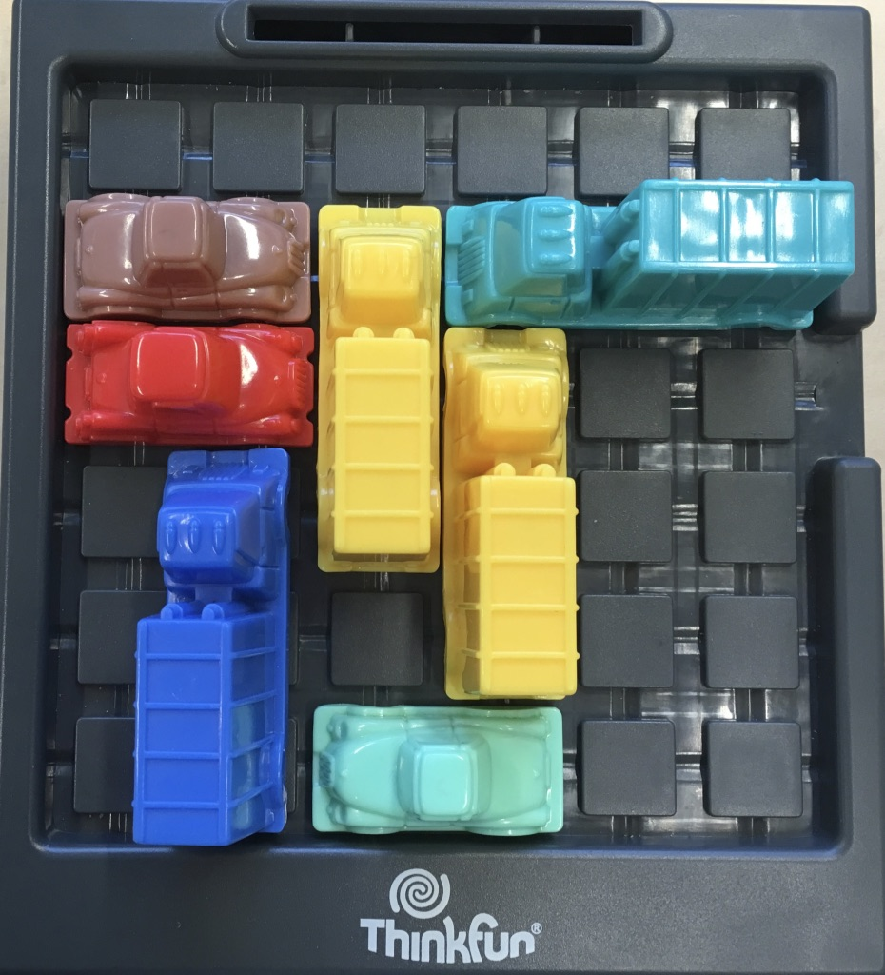
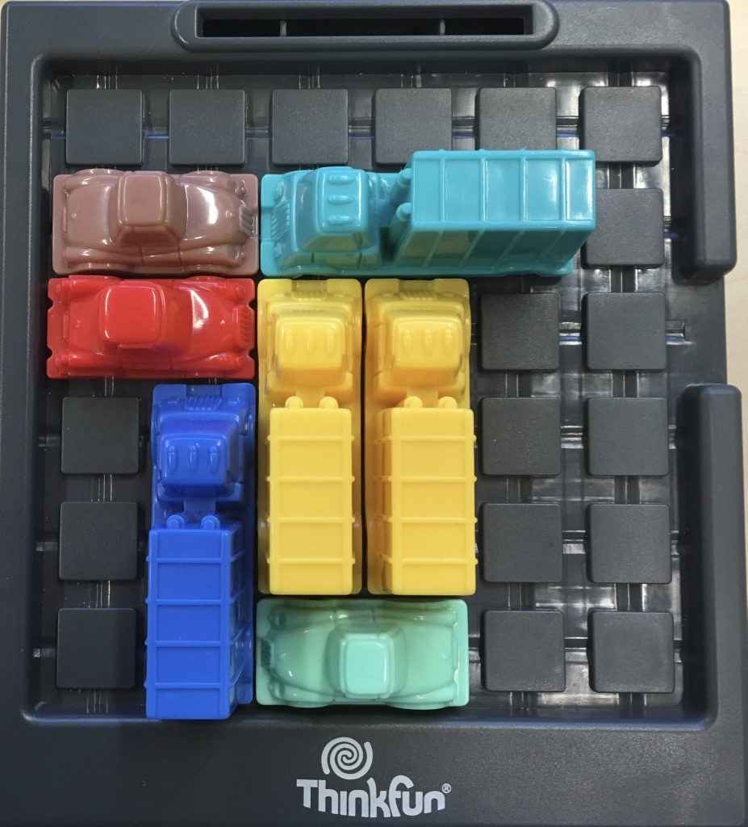
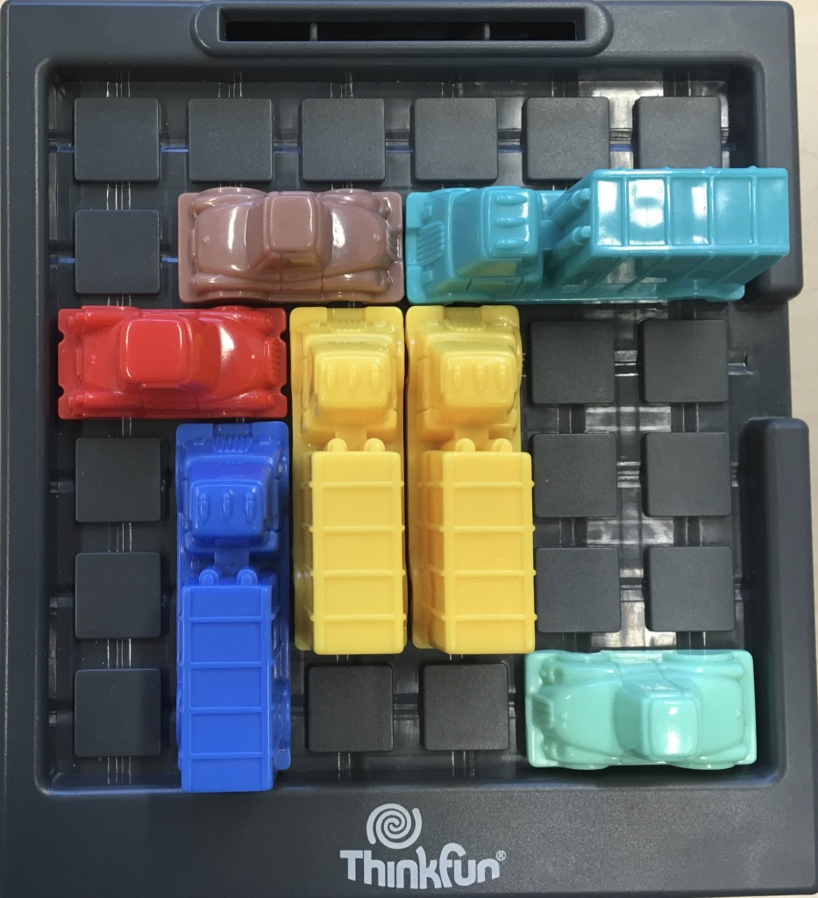
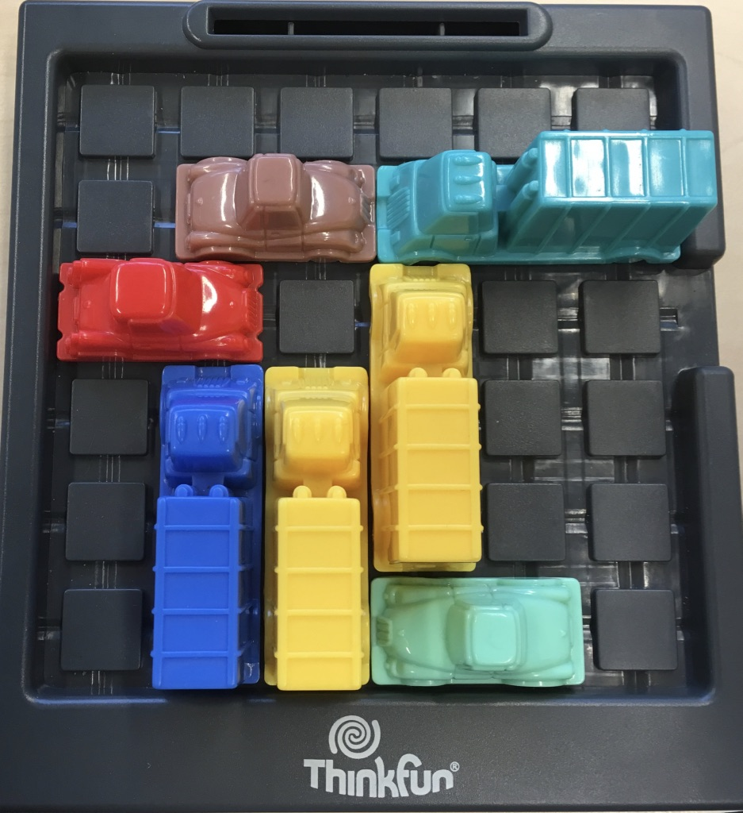

Slide 9
Third algorithm: Depth First Search
Pseudocode:
Initialize stack
Initialize dictionary -> archive
add initial gameboard to stack
add initial gameboard to archive
While stack is not empty:
Remove gameboard from stack
check if gameboard is solved
else:
for each child in possible move:
create gameboard
check if gameboard is in archive
else:
append child to stack
append child to archive

Slide 11
Backtracking
Dictionary: child:parent 1:0 2:1 3:1
Find path
Find moves
1
2
3
4
5
6
7

Slide 12
Breadth First vs. Depth First
 | Breadth First | Depth First
Game 1 | 83 steps to solution 8678 boards checked 5.19 seconds | 1764 steps to solution 4106 boards checked 2.94 seconds
Game 2 | 30 steps to solution 3946 boards checked 2.99 seconds | 526 steps to solution 669 boards checked 0.53 seconds
Game 3 | 36 steps to solution 559 boards checked 0.28 seconds | 124 steps to solution 246 boards checked 0.12 seconds
Hardest Game | 94 steps to solution 19031 boards checked 16.30 seconds | 1195 steps to solution 9985 boards checked 9.16 seconds
Game 4 | 52 steps to solution 347.019 boards checked 709 seconds | 32.086 steps to solution 32.719 boards checked 91 seconds

Slide 13
Conclusions
Breadth First Search finds the shortest path to the solution
Depth First Search has to check less boards and therefore finds the solution in shorter time
Random solving can solve all the boards, but does not give the path to the solution
Case does not define which is better

Slide 14
Questions

